Slide 1
Belts and Elevators Don’t make it Complicated
John Silva

Slide 2
Bearings
Grease- correct type- food grade(not the same)
Over greasing
Heat monitoring- sensor and or hand held temp gun
Vibration detection
Alignment

Slide 3
Elevator Belt Alignment
Head pulley
Bearing and shaft alignment
Belt splicing (how many is too many)
Lagging - crown or flat
Ventilation
Belt speed
Bucket design

Slide 4
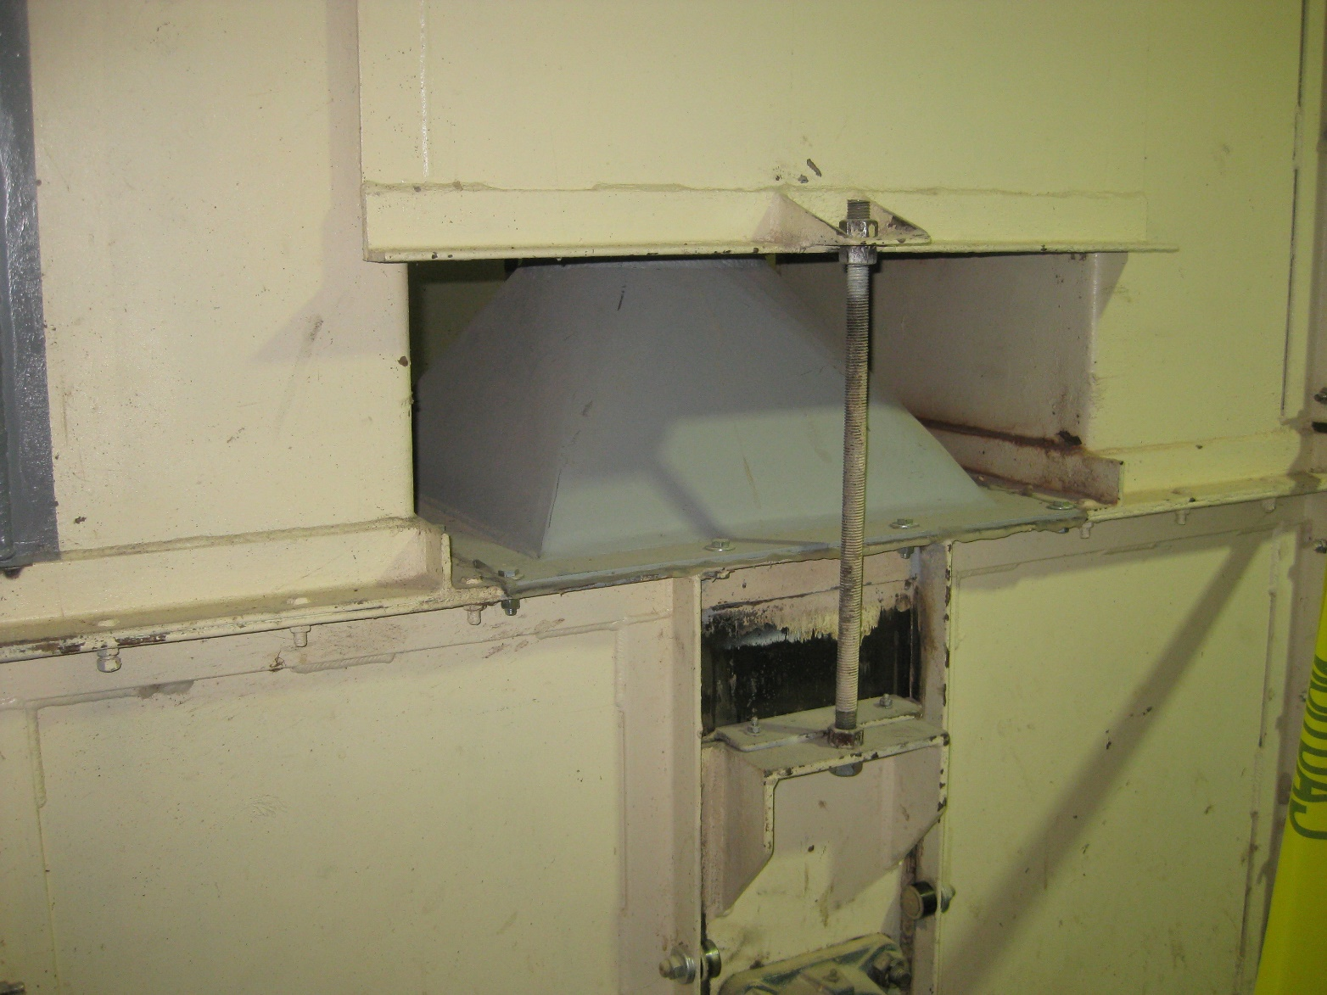
Typical venting

Slide 5
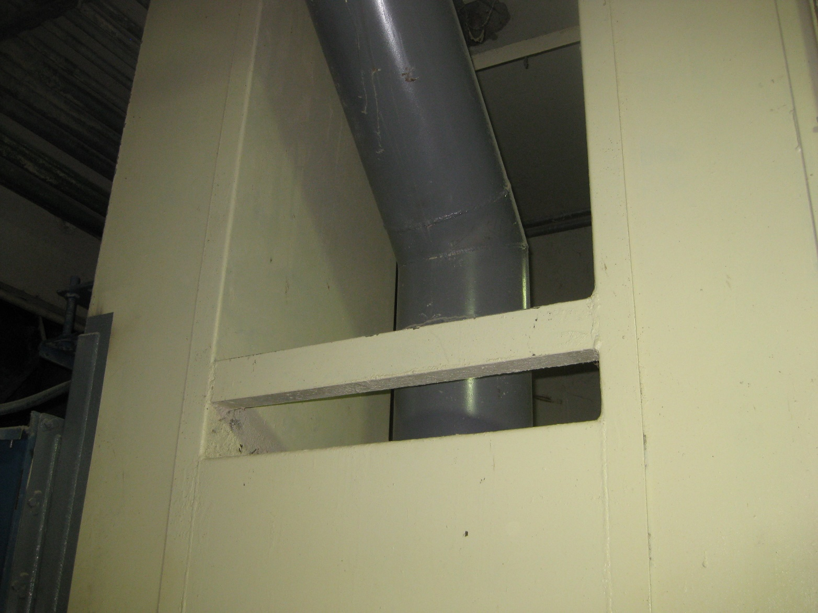
Elevator boot vent

Slide 6
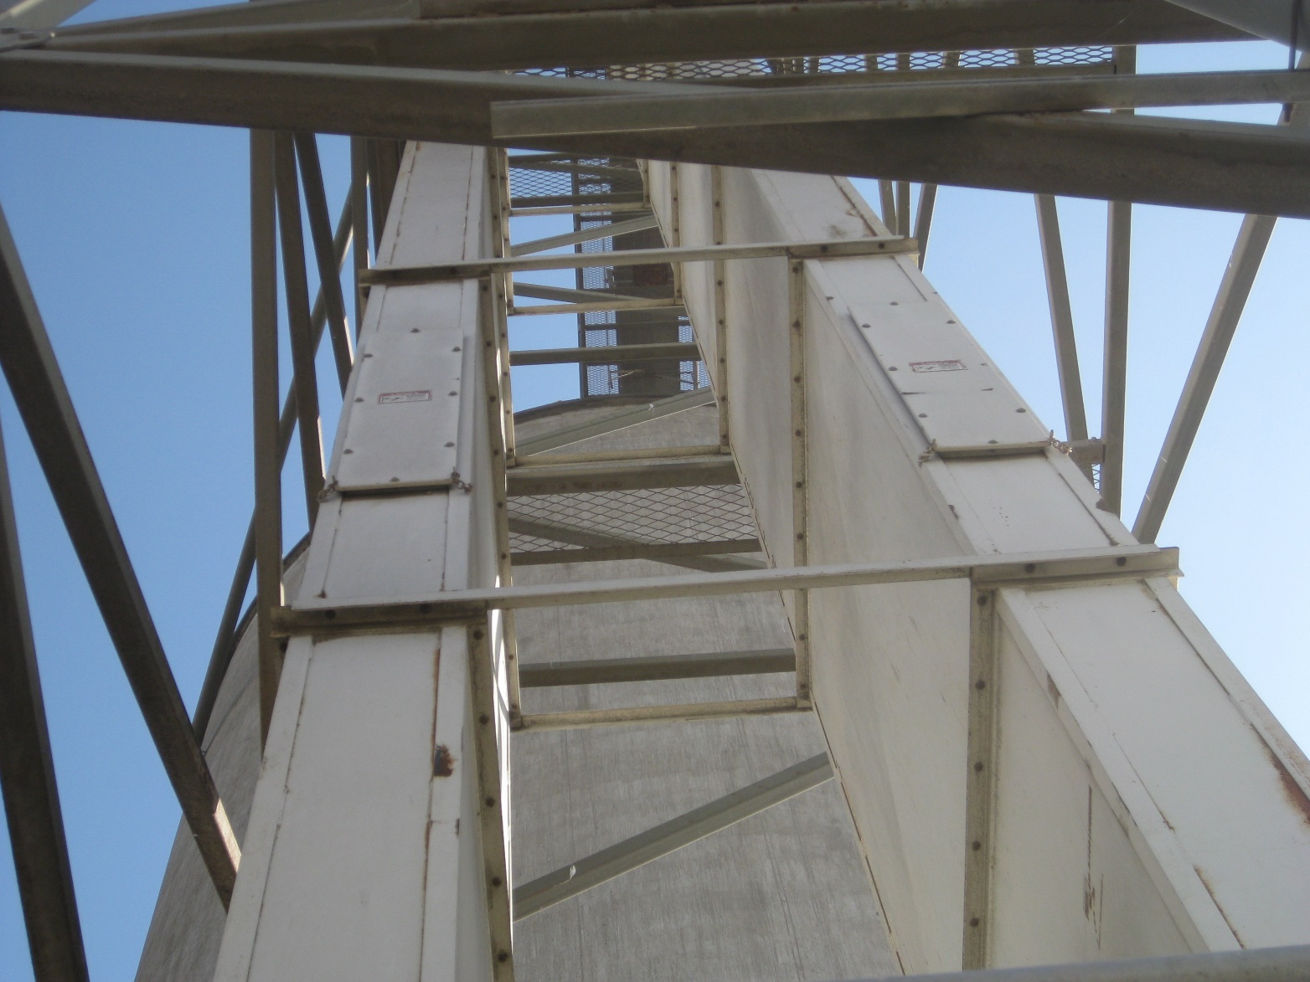
Explosion panels

Slide 7
Questions

